Slide 1



NIRAKULA TECHNOLGIES PVT.LTD
PRESENTS
PMS(Payroll Management System)

Slide 2
PROBLEM STATEMENT
Organizations face challenges in managing payroll due to manual attendance tracking, inaccurate leave records, duplicate employee entries, and time-consuming salary calculations. Employees often lack access to their own payslips and attendance history, while management struggles to generate timely reports. A centralized, automated payroll system is needed to ensure accuracy, transparency, and efficiency..

Slide 3


SOLUTION
Our “ PMS “ i.e Payroll Management System automates attendance tracking, leave management, and salary generation while preventing duplicate employee entries. It provides employees with secure access to their payslips and attendance records, and offers administrators interactive reports, CSV exports, and automated payslip emailing. This centralized system ensures accuracy, saves time, and enhances transparency between employees and management.

Slide 4


FEATURES

Slide 5
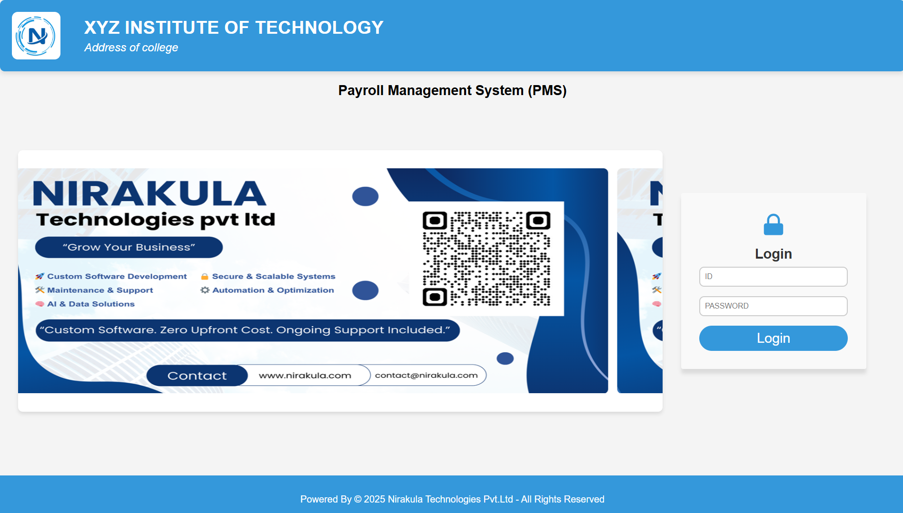
1 . LOGIN PAGE
Experience seamless access with our single-login system, designed to serve multiple types of users efficiently. Whether you're a employees, administrative staff, log in securely to access personalized dashboards and features.

Slide 6
2 . EMPLOYEE LOGIN :
→ Employee login contains college identity in header and also some details of employee also employee photo can be use their .
→ Employees are having options like :
1 . My payslips : where generated payslips are listed and can be downloaded .
2 . My attendance : where attendance of employees are listed .
3 . Apply for leaves : where they can apply for leaves and wait for status of leave wheather granted or rejected .
4 . My leaves : where history of leaves are listed with the status .

Slide 7
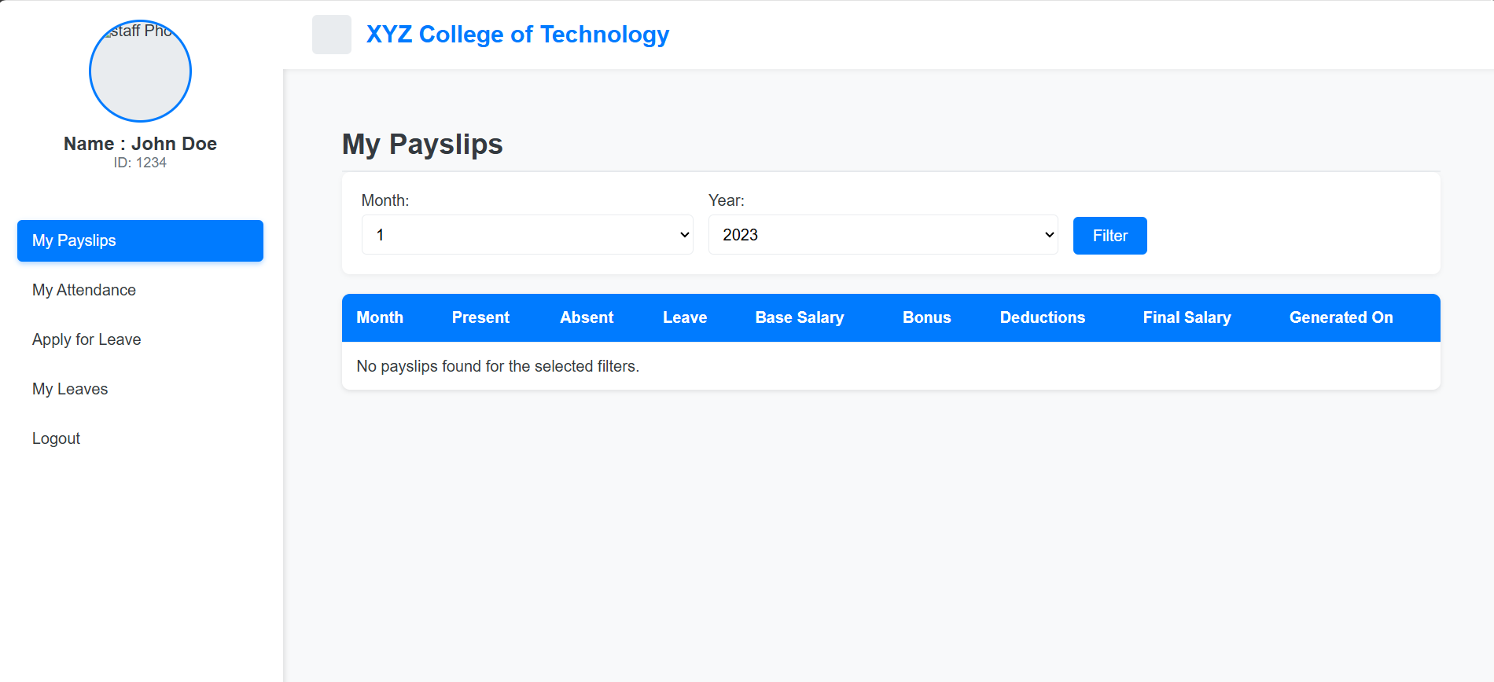
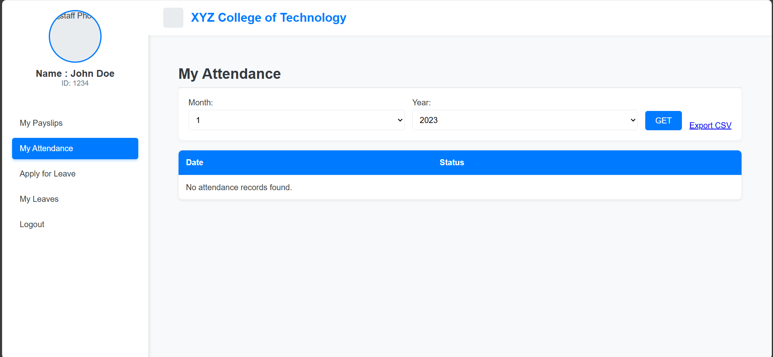
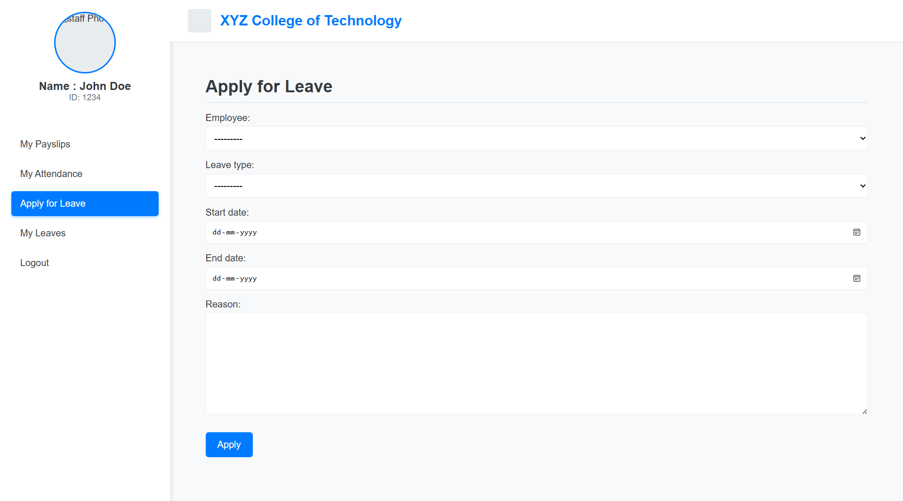
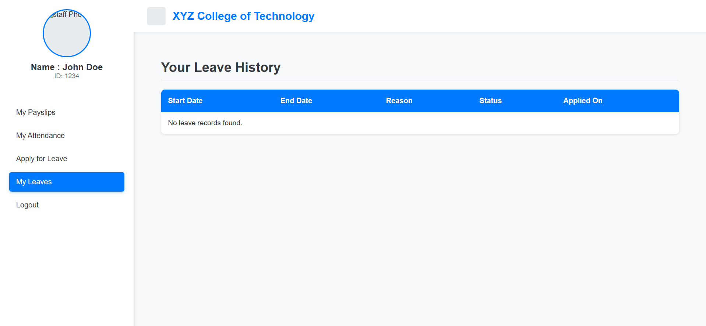

Slide 8
2 . ADMIN LOGIN :
It will be the main supervisor of all authentications for Employees and the required details like name , id , image , email , passwords etc is managed by Admin . It has multiple options like :
1 . Dashboard : which have real time statistics like salary distibutions , Attendance stats etc
2 . Add Employees : where employee data , authentications and photo’s can be uploaded .
3 . Employee : where employee list is displayed where details can be edited and specific employee can be deleted .
4 . Salary list : where generated salaries are displayed .
5 . Salary generator : Where employees salaries are generated with one click .
6 . Leave Management : Where the leave applications are displayed and can be approved or rejected by admin .
7 . Attendance : where attendance can be uploaded , summary of attendance like total present absent are mentioned using filters like year and attendance list .

Slide 9
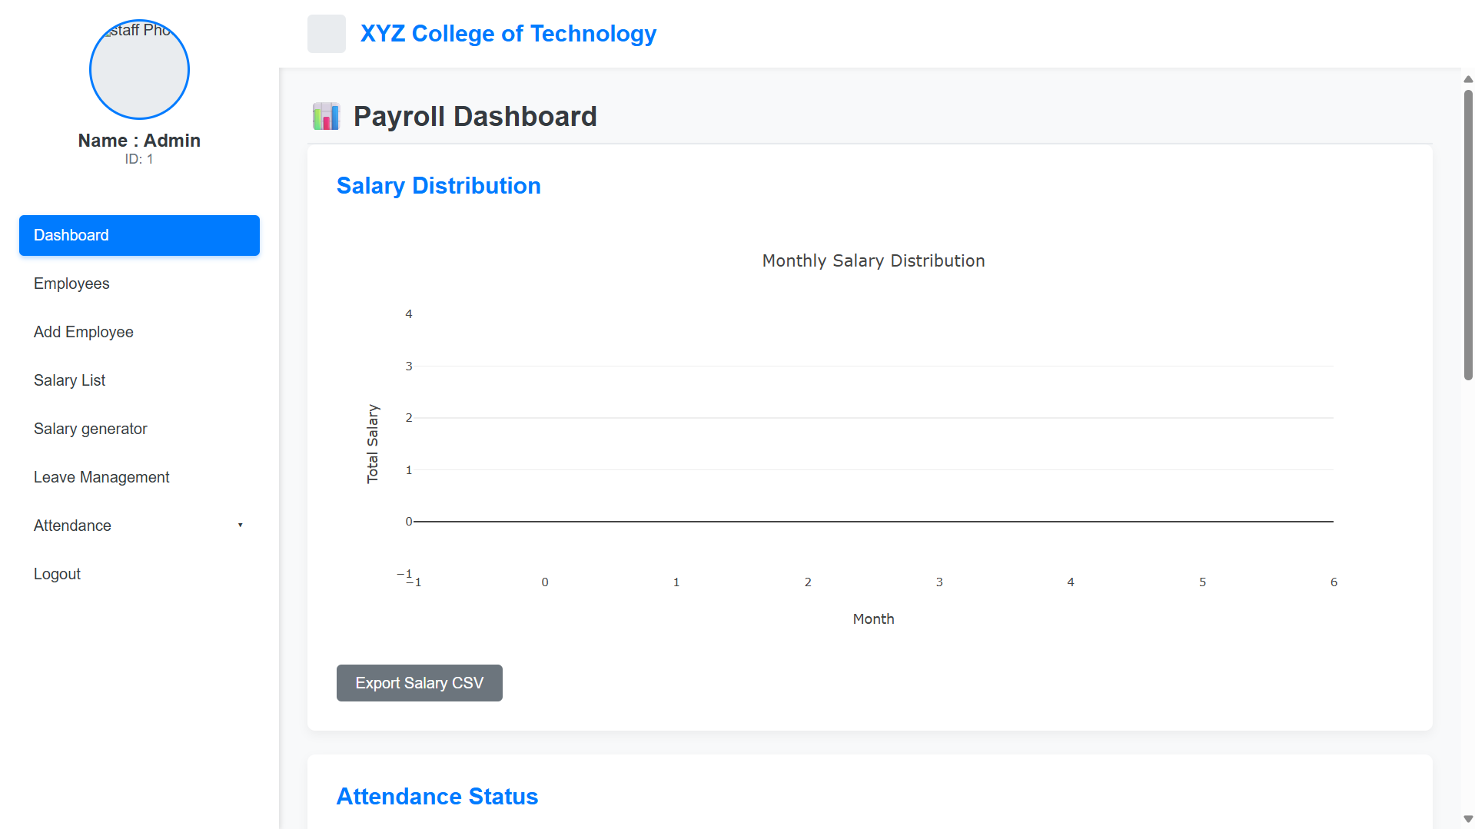

Slide 10
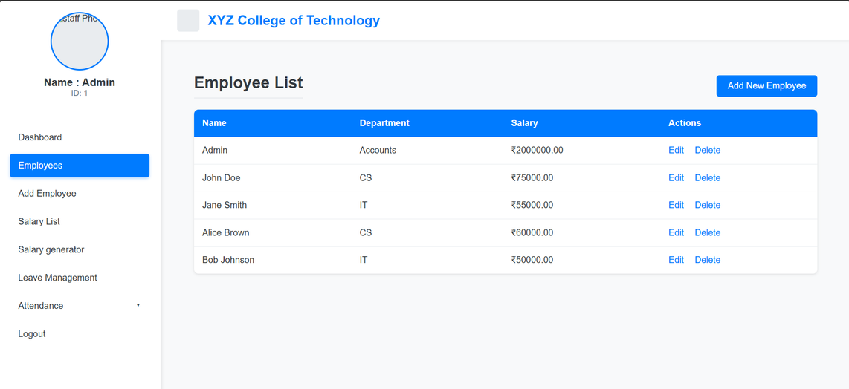
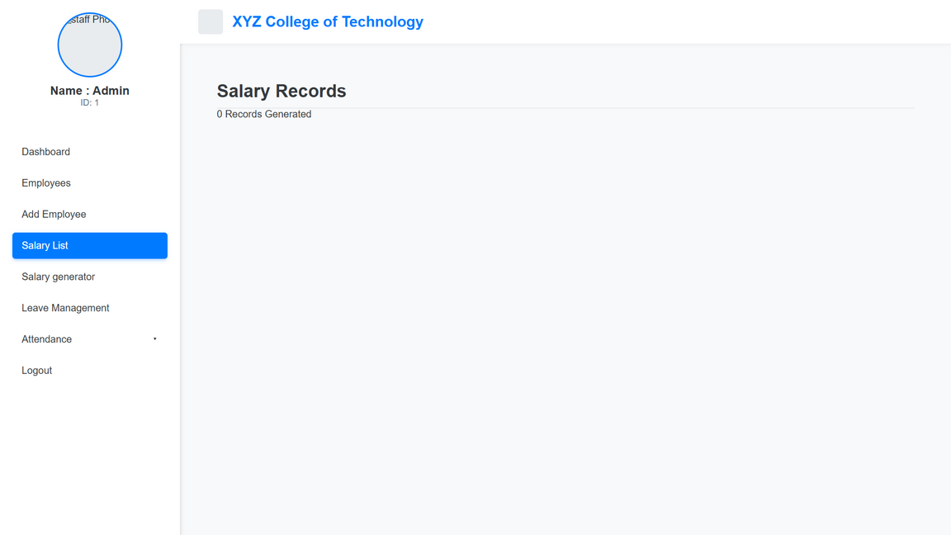
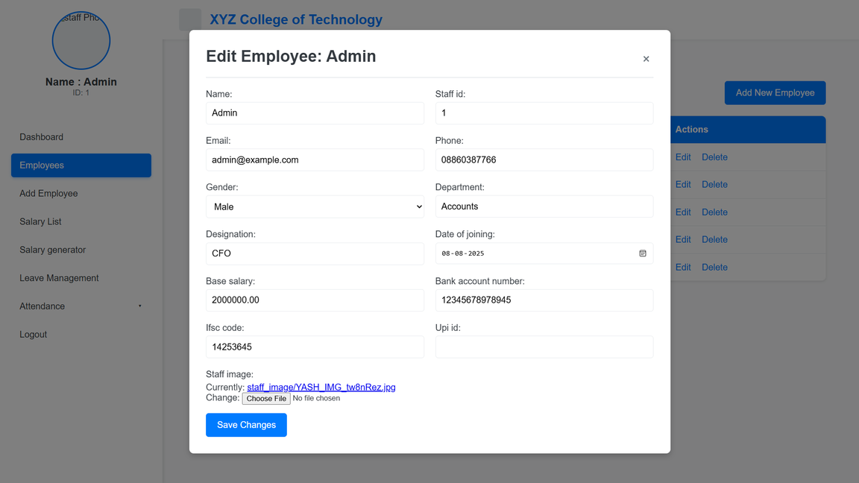
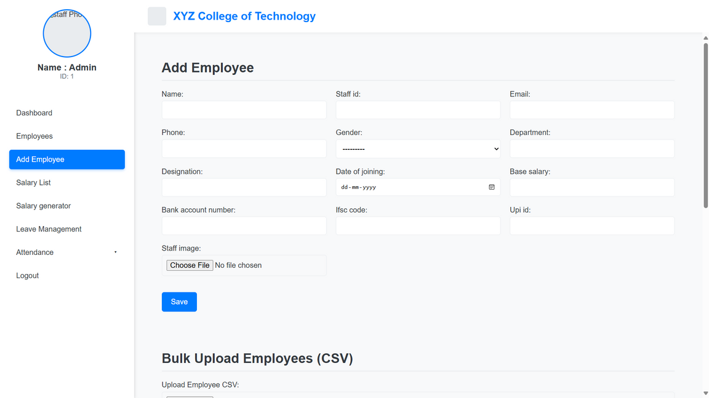

Slide 11
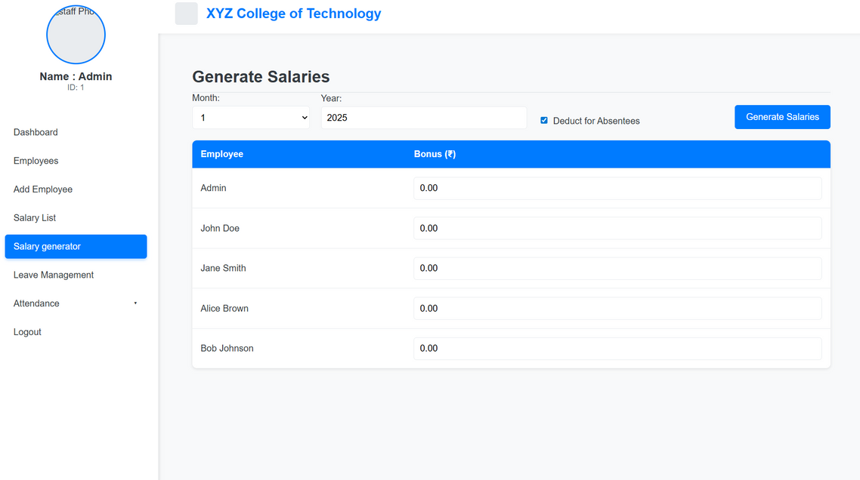
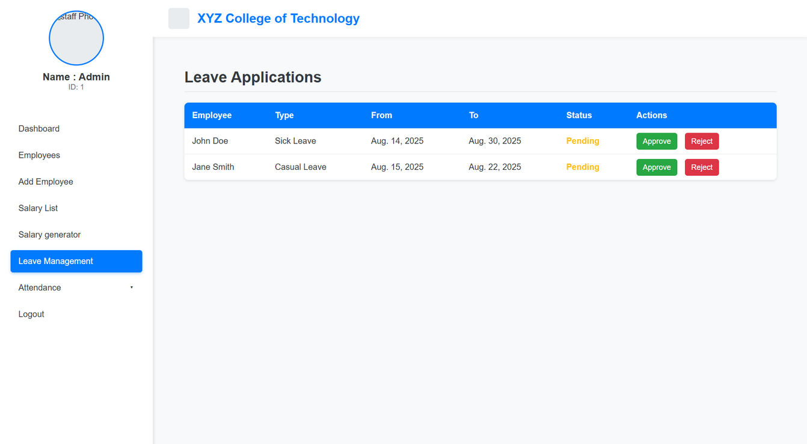

Slide 12
THAT’S ALL , YES IT’S FULLY CUSTOMIZABLE FROM USER INTERFACE TILL FEATURES .

Slide 13


CONTACT US
founder@nirakula.com
www.nirakula.com

Slide 14
THANK YOU

